Slide 1

Book Forever
Guided by : Urvashi Parmar Satish Ranpariya
Robin patel

Slide 2
Introduction:
This is online book selling and buying website. By this website user can able to get information (Personal detail and contact number) of old books and the new books.
By using this website user can upload details of his/her book and personal contact to sell books. This website provides c2c (customer to customer) relationship.
1.1 Purpose:
The purpose of this website is to save time, save money.
This website provides second hand books seller information so the user gets books in lower price.
This website also provides new book seller information.
Automatic acknowledge about new arrivals.
To provide user friendly navigations.
Reuse of books it is helpful for the environment.

Slide 3
1.2 Scope:
This system is in web-based, in which can only be accessed from the Internet.
This system is only providing seller information to the user so it saves time.
C2C relationship provides using this site.
It provides a user friendly environment.
It provides a facility of user feedback

Slide 4
Software Specification:
Client on Internet:
Web-Browser(internet explorer, Chrome, Mozilla Firefox) Windows Operating System: windows xp,7 , 8 , 10 Data Base Server: MSSQL Server 2012 Development End: ASP.NET ( Using C#) & MS SQL Server ( 2012 ) Hardware Specification: Hard-disk: 40 GB Ram: 512 MB Processor: Pentium 4 at 500 MHz

Slide 5
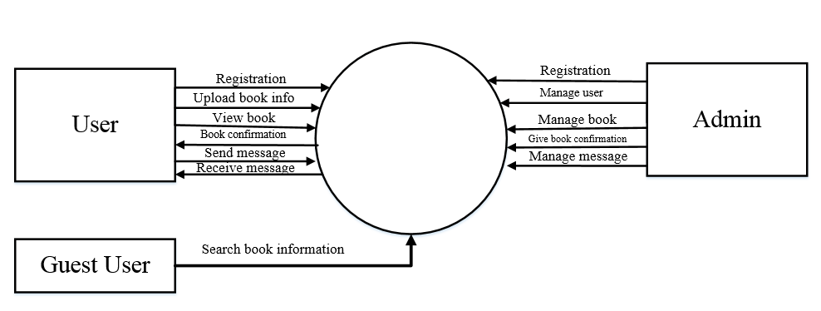
DFD Level-0 Diagram for Book forever system:

Slide 6
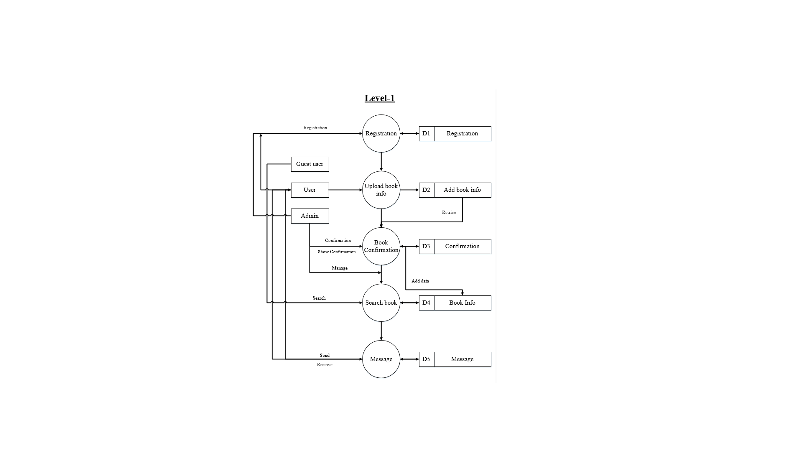
DFD Level-1 Diagram for Book forever system:

Slide 7
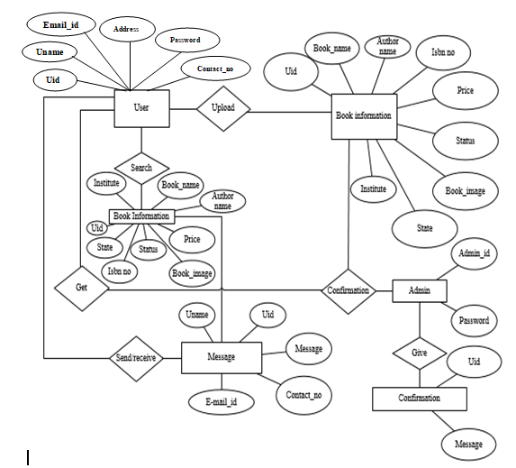
ER Diagram for Book forever system:

Slide 8
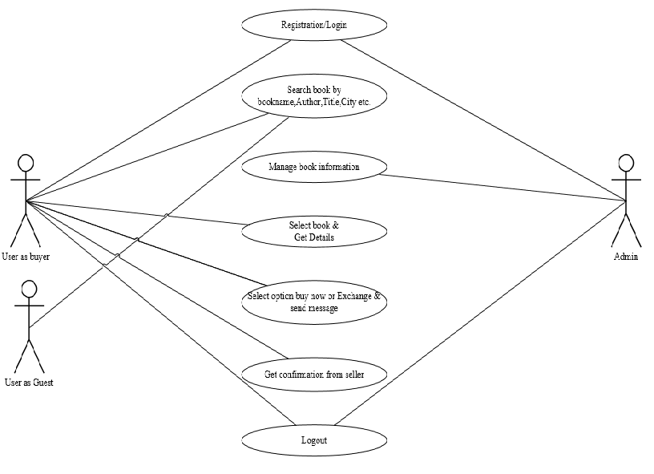
Use case Diagram for user as buyer:

Slide 9
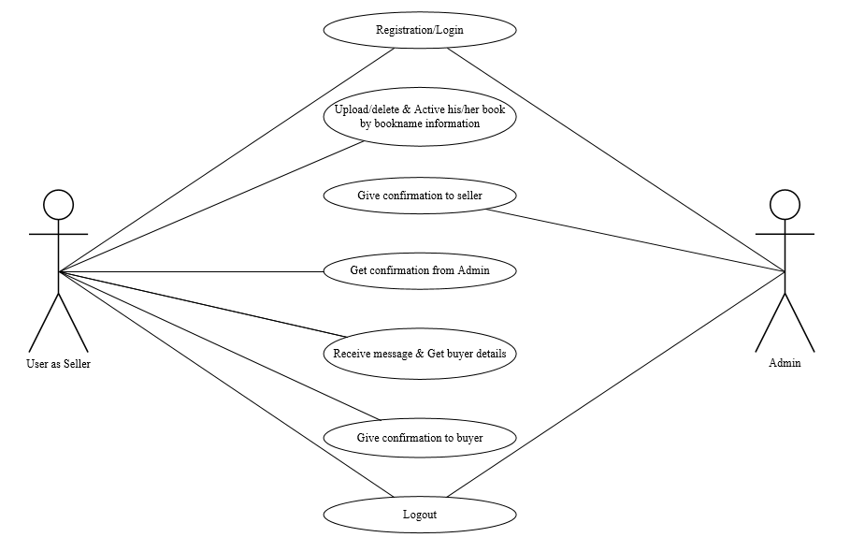
Use case Diagram for user as seller:

Slide 10
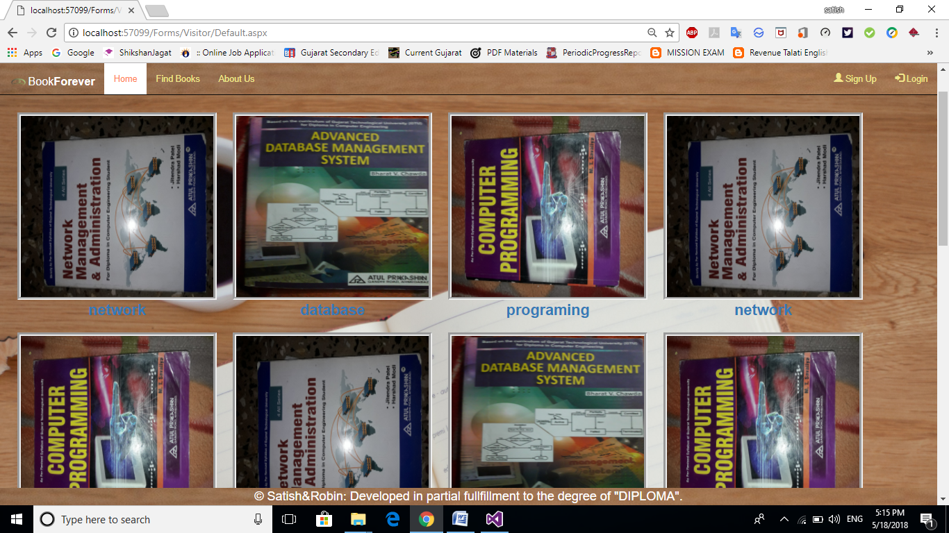
Default page:
Description:
This Page Show list of books which is available for Buy.

Slide 11
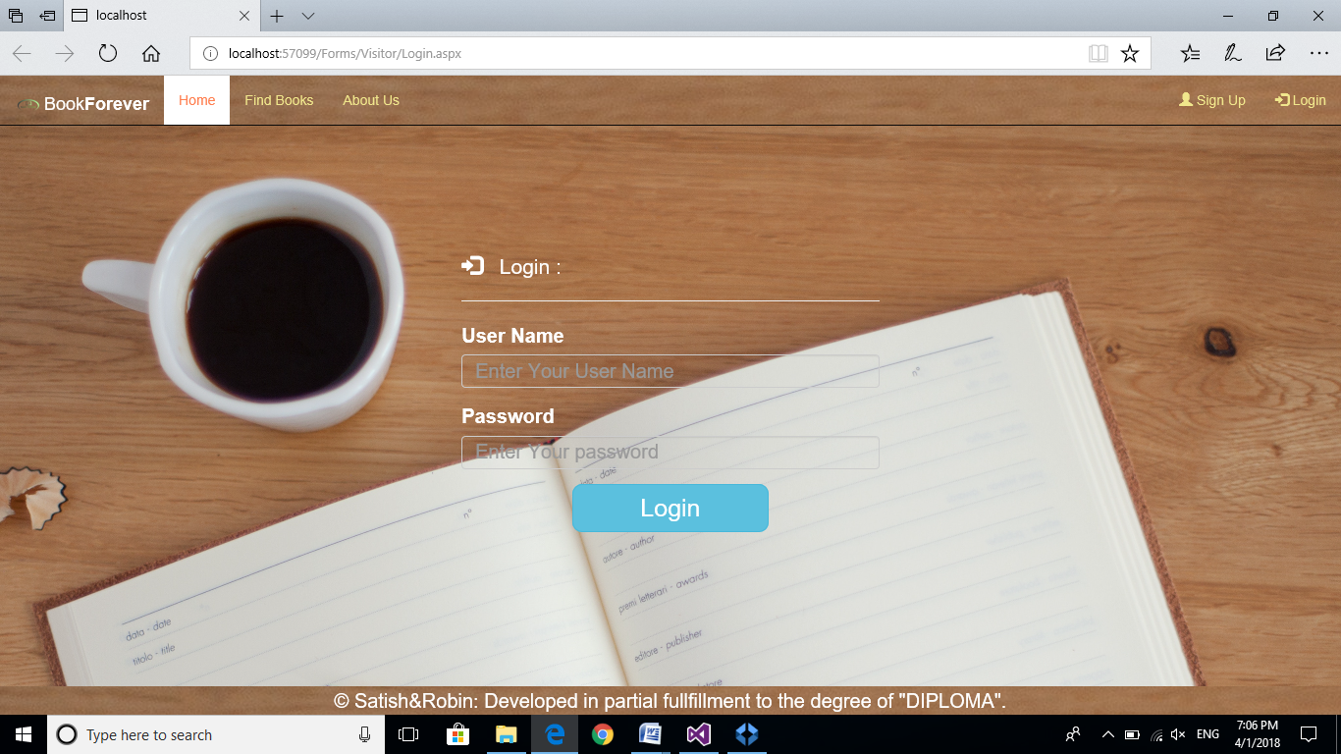
Login page:
Description:
This Page Contain User can login by using Login page(User Name And Password).

Slide 12
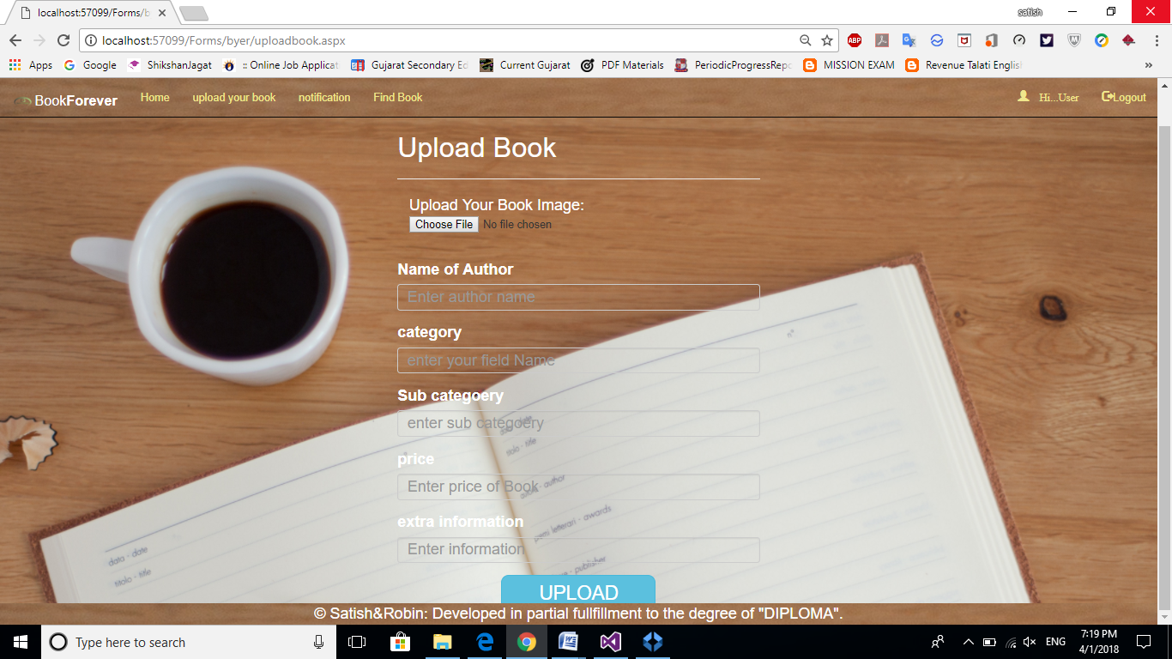
Upload old book information page(SellBook):
Description:
This Page Contain Seller information and Book information.

Slide 13
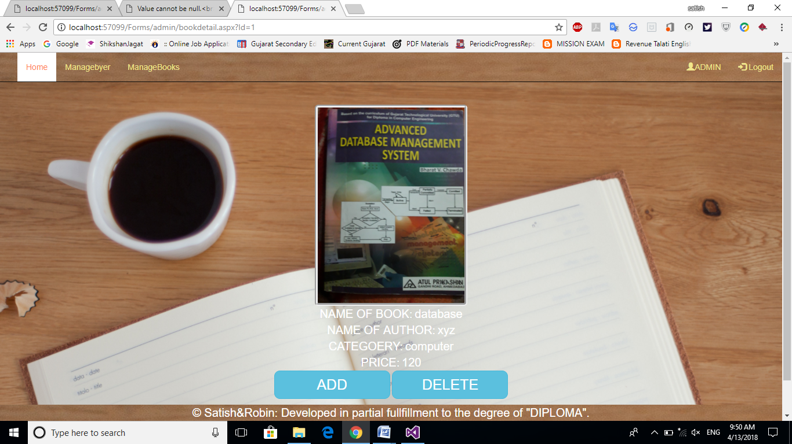
Admin add book:
Description:
This Page Contain list of information upload by seller admin give approval in this page.

Slide 14
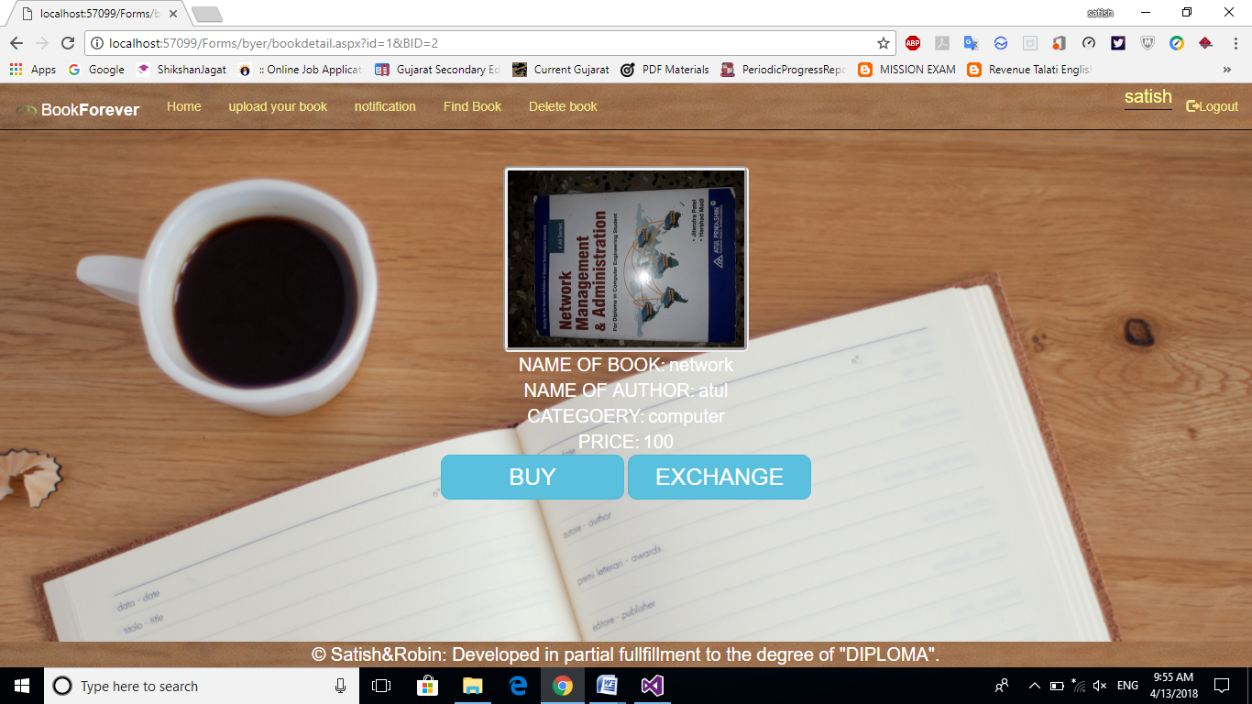
View book :
Description:
This Page Contain list of information upload by seller so user can view.

Slide 15
Limitation:
The project does not provide online transaction. So the buyers will not be able to make online payment.
The project does not provide online transaction. So the seller will not be able to get online payment.
Future Enhancements:
In future we will provide the online transaction facility.
In future we will provide an inquiry message facility
Conclusion
The Website can Buying, selling and Exchanging old book at online. It’s advantage is
save the time and it’s helpful for save environment of Book-reuse.

Slide 16
Thank you…

